Slide 1
应用统计与深度学习实验课
高婷
2021年9月16日

Slide 2
Self Introduction
Ting Gao (高婷） tgao0716@hust.edu.cn
QQ group：343712384（应用统计实验课程）
Office Hour：Fri. 4:00pm - 5:00pm 科技楼704/ Tue. 4:00pm - 5:00pm 恩明楼805
Course Dates: Sep. 16, Sep.23, Sep. 30, Oct. 7
Offline: 科技楼 Room 809
Online: Tencent meeting（会议 ID：337 5097 2341 密码：123456）

Slide 3
Goal
Industry positions: data analyst, data scientist, machine learning engineer, research scientist. ... ...
PhD students / researchers
learning by doing ！
University vs. Training Agencies vs. Self Learning
- learn to start a research project (What? How? Why? --> your innovation?)
- learn to work as a team member (Productivity)
- learn skills for long term career path (Life-long learning)

Slide 4
Final project
Group project: 2-3 people per group
Proposal (template) : deadline Oct.5
Final report (template): deadline Oct. 21
Projects pool: link

Slide 5
Outline
Data manipulation, visualization and popular data mining basics
Numpy, Pandas, Matplot, Seaborn, SKlearn
Deep Learning basics
Pytorch vs. Tensorflow
MLP, CNN, RNN, LSTM, Transformer, VAE ....
Tensorboard, ML pipeline, optimization and other tricks
Applications:
Recommendation System
Computer Vision
Natural language processing
Numerical PDE and Dynamical Systems

Slide 6
Outline
Data manipulation, visulization and popular data mining basics
Numpy, Pandas, Matplot, Seaborn, SKlearn
Deep Learning basics
Pytorch vs. Tensorflow
MLP, CNN, RNN, LSTM, Transformer, VAE ....
Tensorboard, ML pipeline, optimization and other tricks
Applications:
Recommendation System
Computer Vision
Natural language processing
Numerical PDE and Dynamical Systems

Slide 7
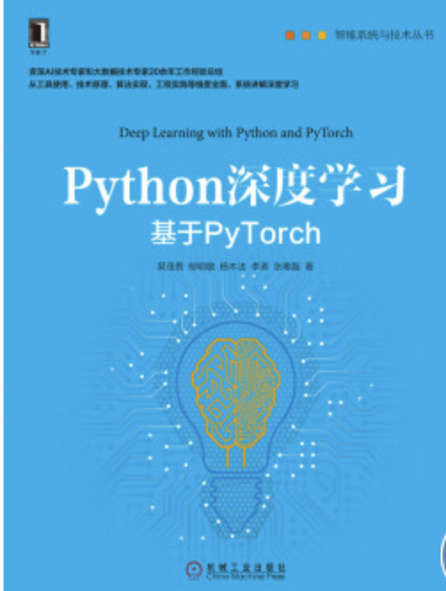
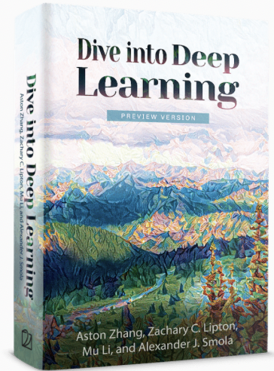
reference books
https://d2l.ai

Slide 8
Lesson 1 summary
1. 1 Python for data science
1. Numpy
2. Pandas
3. Matplotlib ( Seaborn, Sklearn )
1.2 Pytorch for machine learning
1. Installation
2. Data manipulation
3. Linear regression
4. Logistic regression (binary classification)
5. MLP

Slide 9
Why Numpy？

Slide 10
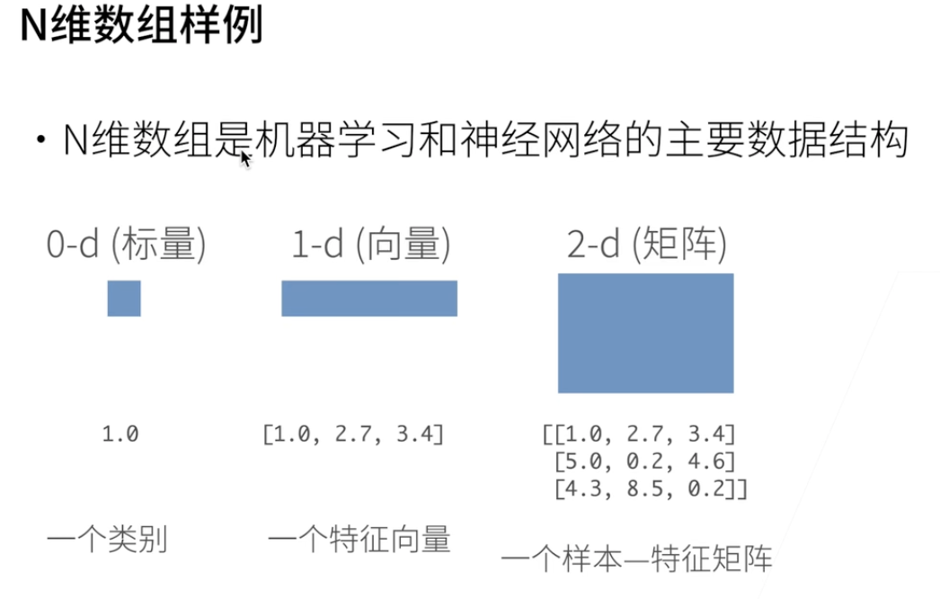

Slide 11
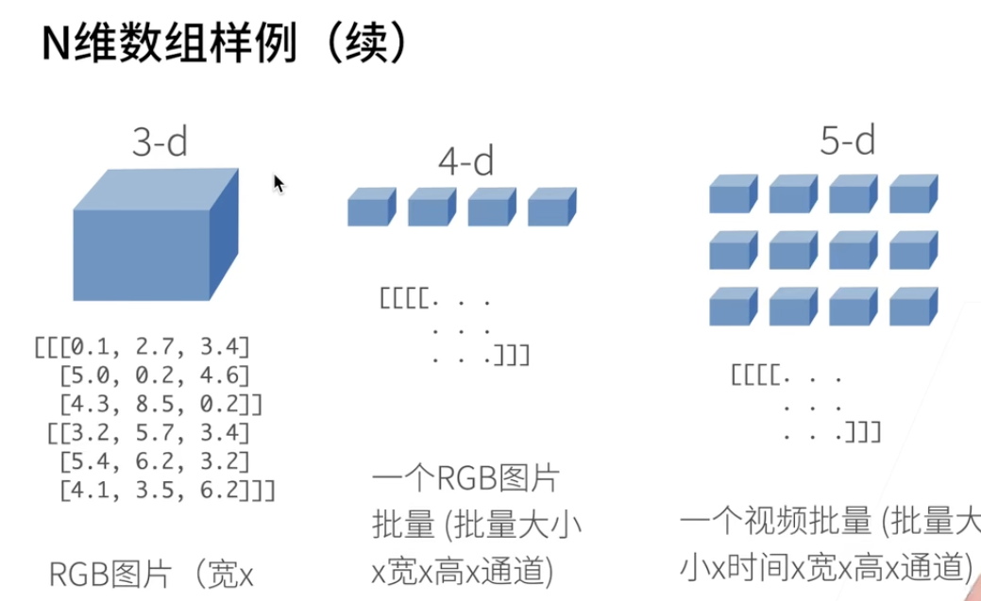

Slide 12
Refreshment

Slide 13
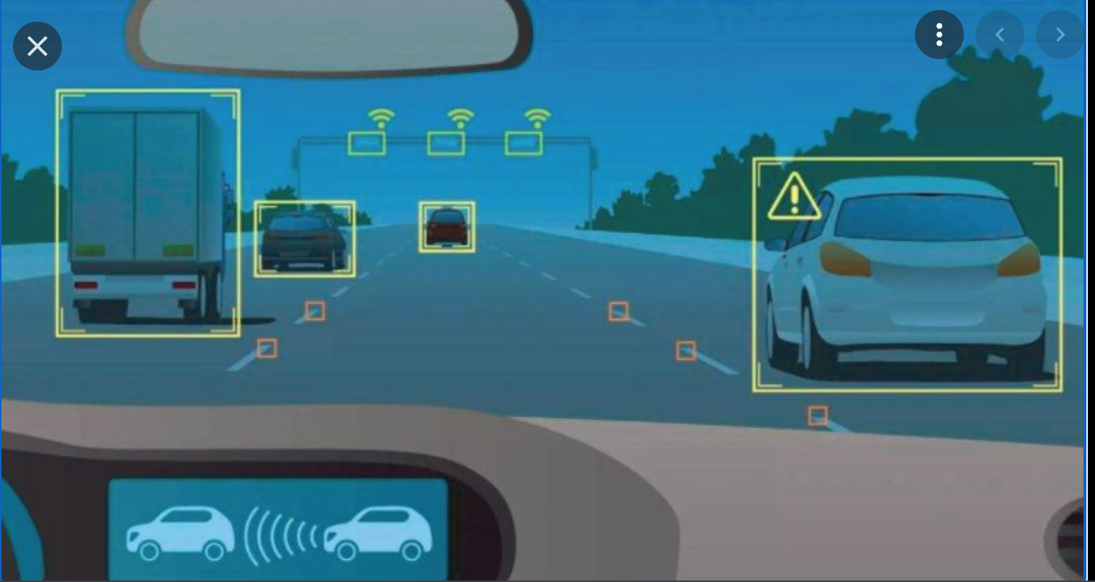


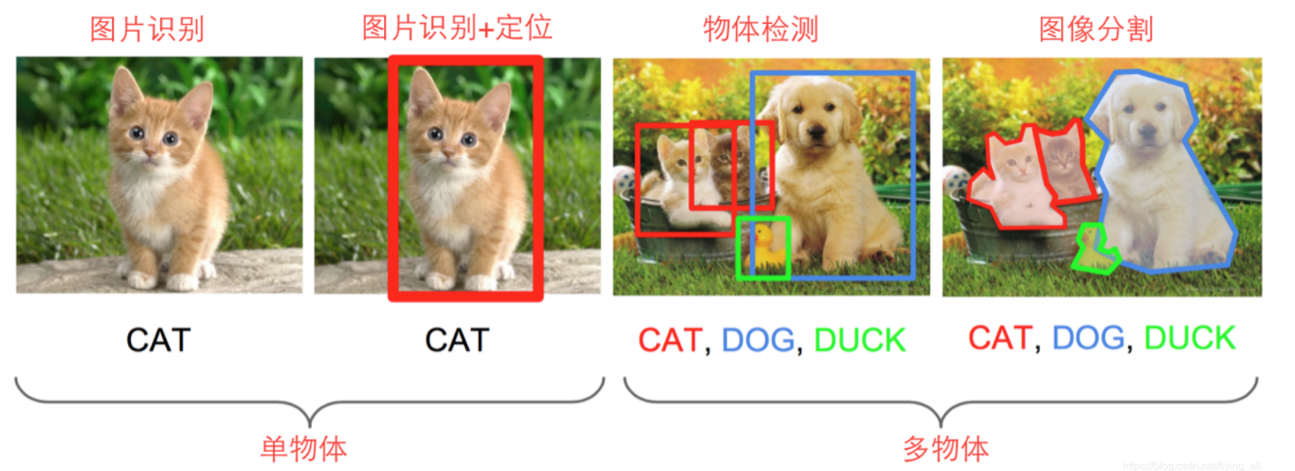
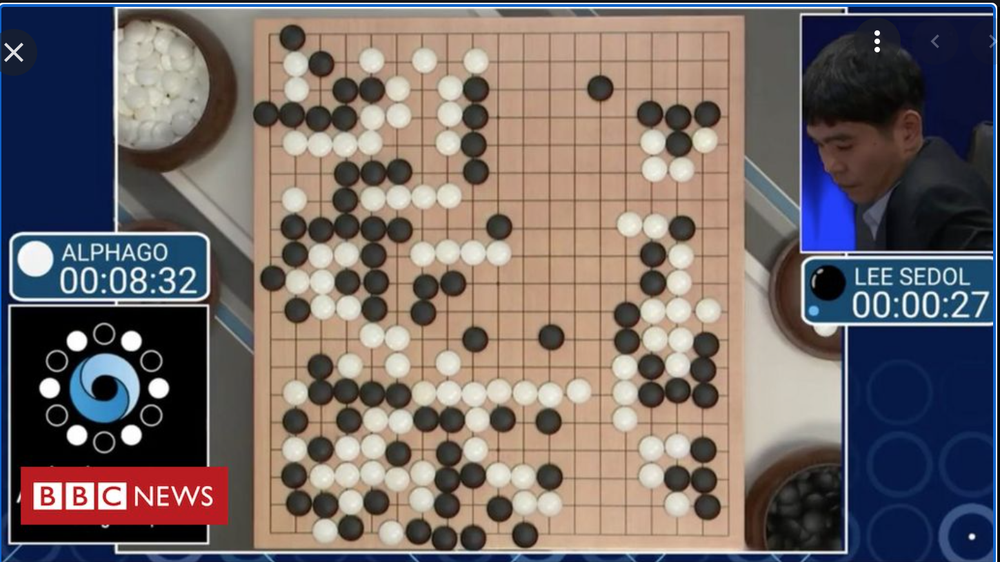

Slide 14
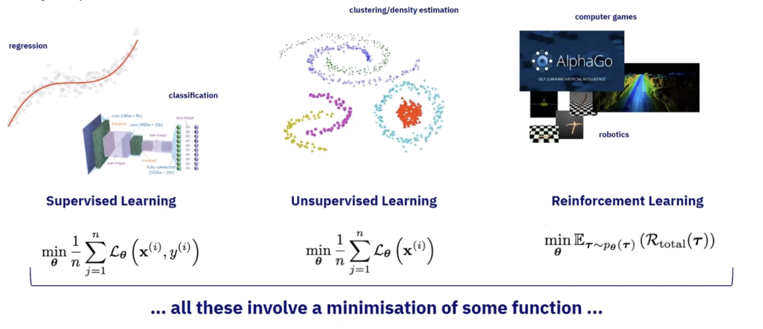
Input
Model
Loss Function
Output

Slide 15
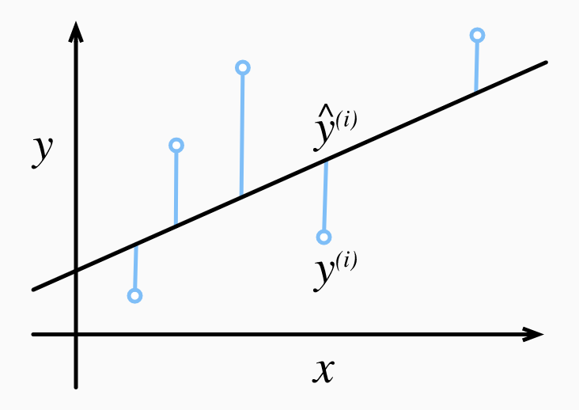
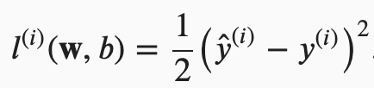
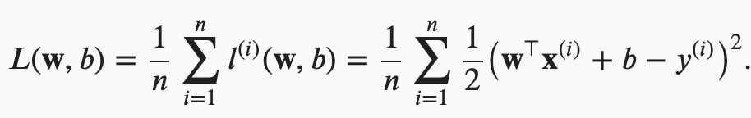
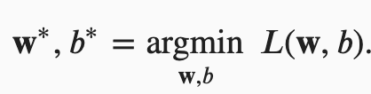
Linear regression

Slide 16
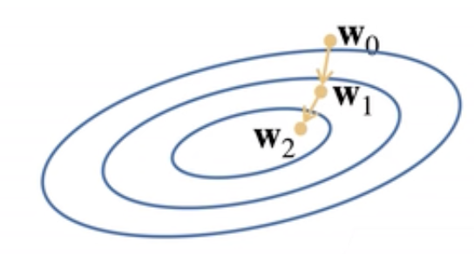
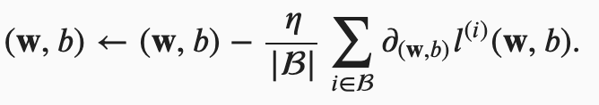
Linear regression
Gradient
Descent:

Slide 17
Linear regression (Deep Learning viewpoint)
Forward propagation:
Backward propagation

Slide 18
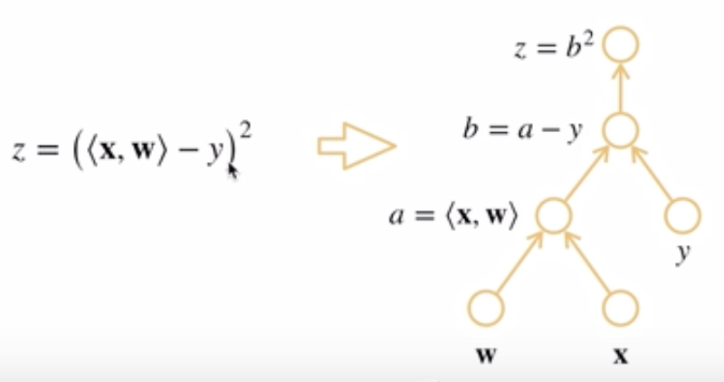
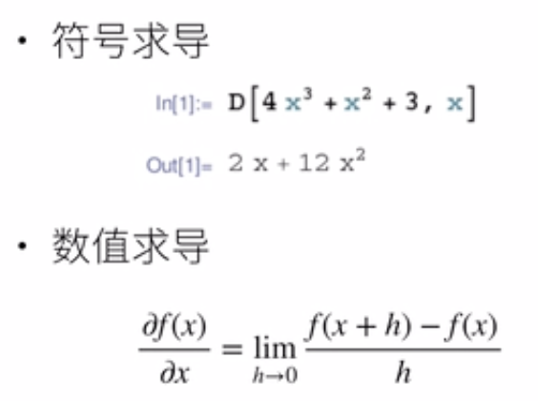
Auto Differentiation (自动微分)

Slide 19
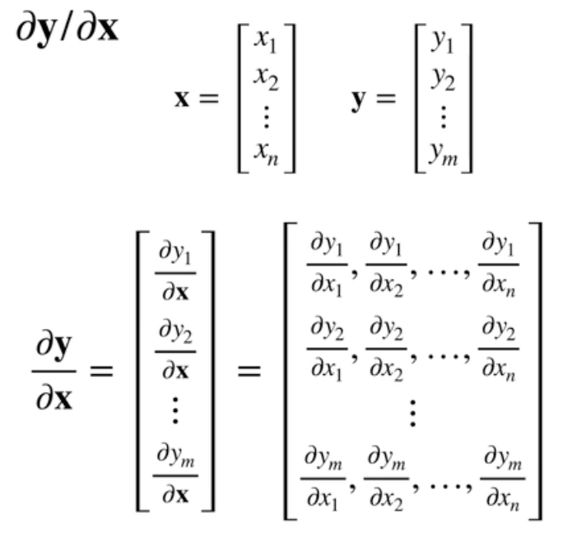
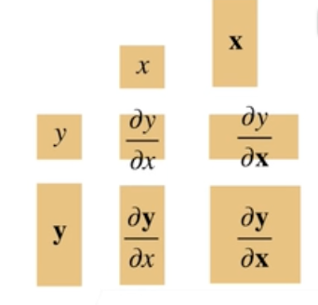
Auto Differentiation (自动微分)

Slide 20
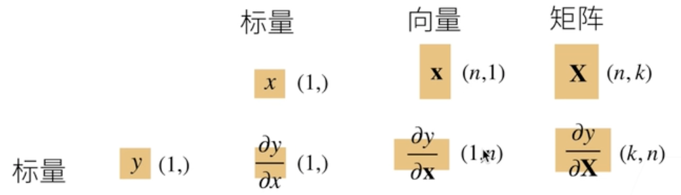
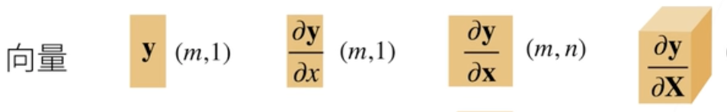
Auto Differentiation (自动微分)

Slide 21
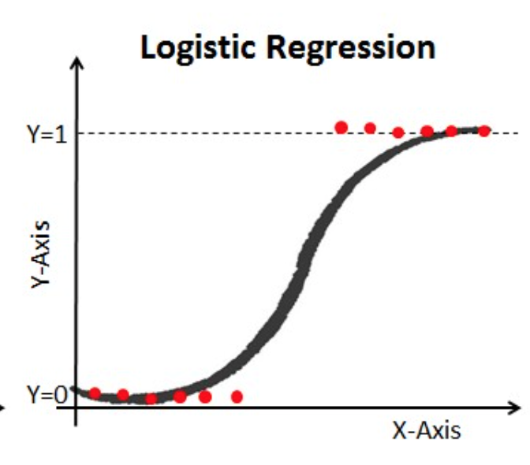
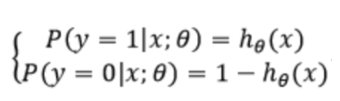
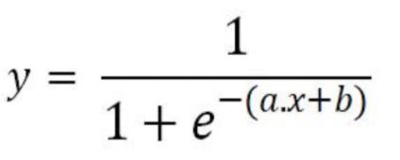
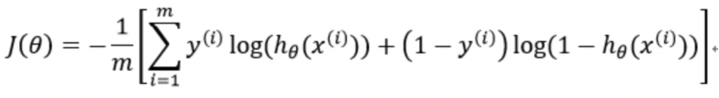
Logistic Regression
Solve: a, b = ?
Cross Entropy Loss

Slide 22
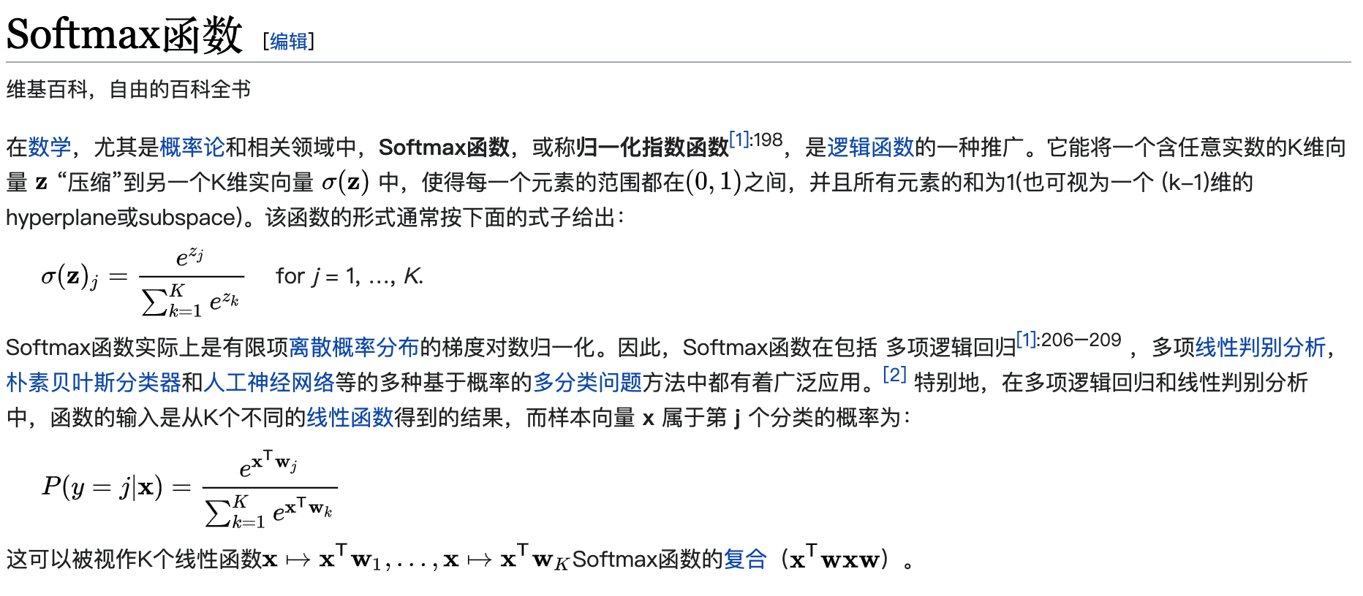
Multi-class Classification

Slide 23
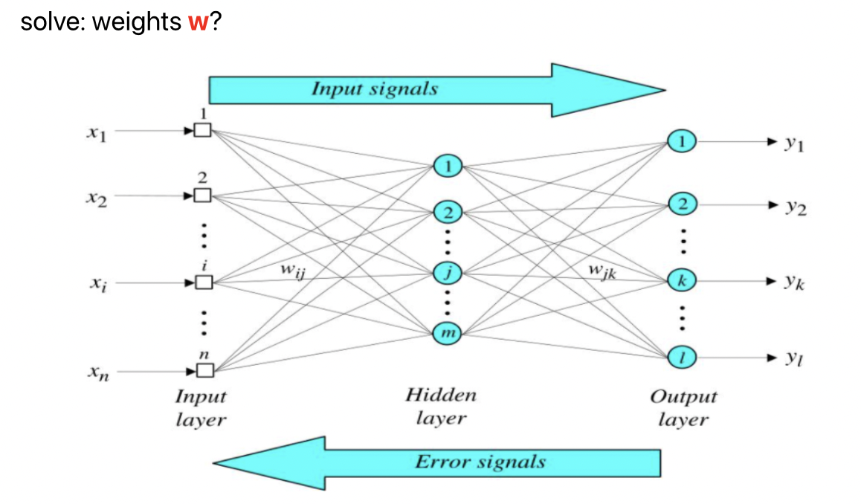
MLP (Multi-Layer Perceptron)

Slide 24
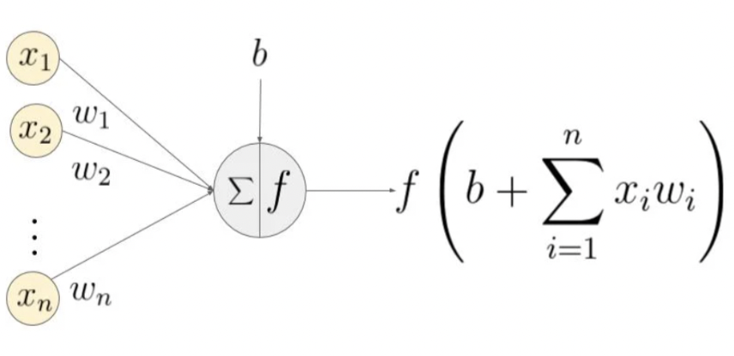
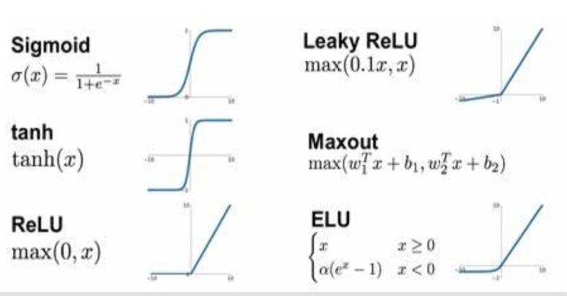
MLP (Multi-Layer Perceptron)
f: activation function

